Slide 1

Shock Alert Monitor
Find, connect, save.
Alejandro Sánchez Roncero
Rafael Otero Escudero
Pablo Pastor Berdún
Víctor Manuel López Higueras
MATHACK 2022
Team 3

Slide 2

Contents
1. What is SAM?
2. How it works?
3. Conclusions

Slide 3

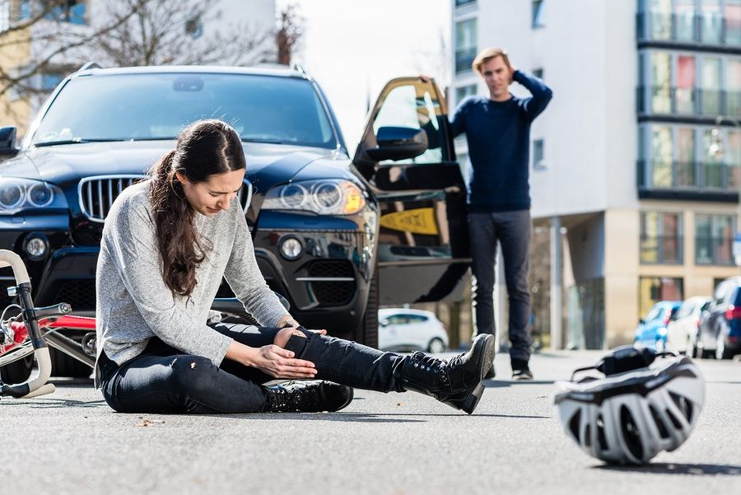
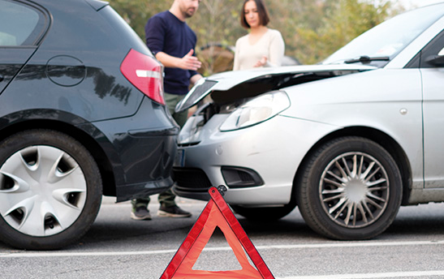
1. What is SAM?
Shock Alert Monitor
MATLAB Mobile Service for detect any kind of shock in different situations.
Fall to the ground, car accident…

Slide 4











2. How it works?

Slide 5






3. Conclusions
Improving healthcare by reducing arrival time of medical staff.
Helping people who live far from big cities and whose healthcare access is not totally guaranteed.
Extending the Smart City concept by providing useful information for city services.

Slide 6
Thank you for your time
Let’s see a demo!
Alejandro Sánchez Roncero
Rafael Otero Escudero
Pablo Pastor Berdún
Víctor Manuel López Higueras
MATHACK 2022
Team 3
Shock Alert Monitor

